Slide 1


Slide 2


Copyright And Confidentiality
All content of this material, including text, images, audio, video,software,programs,tools etc., are collected online.
Visitors may use the content or services provided in this material for personal study, research or appreciation, as well as other non-commercial or non-profit uses, but at the same time comply with the provisions of the Copyright Law and other relevant laws, and may not infringe this information and related the legal rights of the right holder. In addition, any use of any content or service of this material for other purposes requires the written permission of the person and payment.
牧云/罗伟
Network | IaaS | PaaS | ServiceMesh
交流 学习 沉淀 成长 分享
olaf.luo@foxmail.com
https://www.yuque.com/wei.luo
https://youdianzhishi.com
All Rights Reserved.

Slide 3
Rowan Luo
交流
学习
沉淀
成长
分享
Kubernetes Environment Preparation
Revision Date: 2023/02/23
Version：v1.5
DocID：CN00002023XLW

Slide 4
Kubernetes Environment Overview-VMWare Network Type
Whether you just bought yourself a copy of VMware Fusion (for your Mac), Workstation (for Windows or linux) or are using Player, Ace, or even the old VMware Server product, you’ll be soon setting up your first virtual machine. Your new vm is going to want to talk to the outside world just like your physical machine, so it’s a good idea to understand some basic options available to you to ensure your new vm works right out of the box. There are three types of networking available to virtual machines. Each type has its own uses, behaviors and features. They are as follows:
Bridged networking
Host-only networking
Network Address Translation (NAT) networking
Using the wrong networking type or configuration settings may result in undesirable behavior, and frustration on your part, so lets understand these three variations and what they mean to you.
Bridged networking connects a virtual machine to a network using the host computer’s Ethernet adapter. If your host computer is on an Ethernet network ,this is often the easiest way to give your virtual machine access to that network. If you use bridged networking, your vm is a full participant in the network. It has access to other machines on the network and can be contacted by other machines on the network as if it were a physical computer on the network. This is a frequently used option.
Host-only networking creates a network that is completely contained within the host computer. Host-only networking provides a network connection between the virtual machine and the host computer. In this setup, your vm will not have access to the outside world, only the physical machine your are running it on. This approach can be useful if you need to set up an isolated virtual network.
Network Address Translation, or NAT for short, gives your virtual machine access to network resources using the host computer’s IP address. How is this different than bridged you ask? If you use NAT, your virtual machine does not have its own IP address on the external network. Instead, a separate private network is set up on the host computer. This method might be best if your virtual machines do not provide services but still need to access a network.

Slide 5


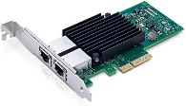
Kubernetes Environment Overview-VMWare Network Type(Bridge Mode)
10.10.10.11/24
10.10.10.12/24
VMWare Workstation 16.x
10.10.10.13/24
10.10.10.14/24
WINX HOST
10.10.10.10/24
Bridged networking connects a virtual machine to a network using the host computer’s Ethernet adapter. If your host computer is on an Ethernet network ,this is often the easiest way to give your virtual machine access to that network. If you use bridged networking, your vm is a full participant in the network. It has access to other machines on the network and can be contacted by other machines on the network as if it were a physical computer on the network. This is a frequently used option.

Slide 6

Kubernetes Environment Overview-VMWare Network Type(HOST-Only Mode)
192.168.56.11/24
192.168.56.12/24
VMWare Workstation 16.x
192.168.56.13/24
192.168.56.14/24
WINX HOST
10.10.10.10/24
Host-only networking creates a network that is completely contained within the host computer. Host-only networking provides a network connection between the virtual machine and the host computer. In this setup, your vm will not have access to the outside world, only the physical machine your are running it on. This approach can be useful if you need to set up an isolated virtual network.

Slide 7

Kubernetes Environment Overview-VMWare Network Type(NAT Mode)
172.12.1.11/24
172.12.1.12/24
NAT
GW:172.12.1.2/24
VMWare Workstation 16.x
172.12.1.13/24
172.12.1.14/24
WINX HOST
10.10.10.10/24
Network Address Translation, or NAT for short, gives your virtual machine access to network resources using the host computer’s IP address. How is this different than bridged you ask? If you use NAT, your virtual machine does not have its own IP address on the external network. Instead, a separate private network is set up on the host computer. This method might be best if your virtual machines do not provide services but still need to access a network.

Slide 8
Kubernetes Environment Overview-Ubuntu20.04 Kernel Upgrade
Upgrade to 5.11:
Access to the below URL:
https://kernel.ubuntu.com/~kernel-ppa/mainline/v5.11/amd64/
2. Download *_all and *generic* file:
Like:
linux-headers-5.11.0-051100-generic_5.11.0-051100.202102142330_amd64.deb
linux-headers-5.11.0-051100_5.11.0-051100.202102142330_all.deb
linux-image-unsigned-5.11.0-051100-generic_5.11.0-051100.202102142330_amd64.deb
linux-modules-5.11.0-051100-generic_5.11.0-051100.202102142330_amd64.deb
3. Install the new kernel:
mkdir -p /root/new_kernel/ && cp -r *.deb /root/new_kernel/ && dpkg -i *.deb
4. Reboot the host and check the current kernel version:
uname -a
Cilium Feature | Minimum Kernel Version
IPv4 fragment handling | >= 4.10
Restrictions on unique prefix lengths for CIDR policy rules | >= 4.11
IPsec Transparent Encryption in tunneling mode | >= 4.19
WireGuard Transparent Encryption | >= 5.6
Host-Reachable Services | >= 4.19.57, >= 5.1.16, >= 5.2
Kubernetes Without kube-proxy | >= 4.19.57, >= 5.1.16, >= 5.2
Bandwidth Manager | >= 5.1
Local Redirect Policy (beta) | >= 4.19.57, >= 5.1.16, >= 5.2
Full support for Session Affinity | >= 5.7
BPF-based proxy redirection | >= 5.7
BPF-based host routing | >= 5.10
Socket-level LB bypass in pod netns | >= 5.7
Egress Gateway (beta) | >= 5.2
VXLAN Tunnel Endpoint (VTEP) Integration | >= 5.2

Slide 9
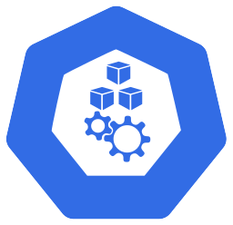

Kubernetes Environment Overview-Network TOPO
v1.23.2
192.168.21.10/24
v1.23.2
192.168.21.1/24
VyOS(1.1.8)
Internet
192.168.2.66/24
192.168.22.10/24
192.168.22.1/24
v1.23.2
192.168.22.11/24

Slide 10
Kubernetes Environment Overview-Install Kubernetes(kubeadm)
cat <<EOF >> /etc/hosts
192.168.2.61 bpf1
192.168.2.62 bpf2
192.168.2.63 bpf3
EOF
apt install -y net-tools tcpdump chrony bridge-utils tree wget iftop ethtool curl
sed -ri 's/.*swap.*/#&/' /etc/fstab && swapoff -a
apt-get update && apt-get install -y apt-transport-https
apt upgrade -y
curl https://mirrors.aliyun.com/kubernetes/apt/doc/apt-key.gpg | apt-key add -
tee /etc/apt/sources.list.d/kubernetes.list <<-'EOF'
deb https://mirrors.aliyun.com/kubernetes/apt/ kubernetes-xenial main
EOF
apt-get update -y
apt install docker-ce
curl -fsSL https://download.docker.com/linux/ubuntu/gpg | sudo apt-key add -
sudo add-apt-repository "deb [arch=amd64] https://download.docker.com/linux/ubuntu $(lsb_release -cs) stable"
sudo apt install docker-ce docker-ce-cli containerd.io
mkdir -p /etc/docker
cat <<EOF > /etc/docker/daemon.json
{
"exec-opts": ["native.cgroupdriver=systemd"],
"registry-mirrors": ["https://cu2yw19m.mirror.aliyuncs.com"]
}
EOF
systemctl daemon-reload
systemctl restart docker
systemctl enable docker

Slide 11
Kubernetes Environment Overview-Install Kubernetes
apt-get install -y kubelet kubeadm kubectl --allow-unauthenticated
systemctl enable kubelet && systemctl restart kubelet
cat > /var/lib/kubelet/config.yaml <<EOF # [master node]
apiVersion: kubelet.config.k8s.io/v1beta1
kind: KubeletConfiguration
cgroupDriver: systemd
EOF
systemctl daemon-reload
systemctl restart docker
systemctl enable kubelet
systemctl restart kubelet
docker info|grep "Cgroup Driver"
Cgroup Driver: systemd
# Master Node:
kubeadm config images pull --image-repository=registry.aliyuncs.com/google_containers
kubeadm init --kubernetes-version=v1.23.5 --image-repository registry.aliyuncs.com/google_containers --pod-network-cidr=10.244.0.0/16 --service-cidr=10.96.0.0/12 --skip-phases=addon/kube-proxy --ignore-preflight-errors=Swap
# Worker Node:
kubeadm config images pull --image-repository=registry.aliyuncs.com/google_containers
kubeadm join 192.168.2.61:6443 --token ac4k64.e3i6j13sryj1twzt \
--discovery-token-ca-cert-hash sha256:7feb5f701bbad147116daddda3e74e720738e61938eedccc7bfaa3d24aed23bf
mkdir -p $HOME/.kube
sudo cp -i /etc/kubernetes/admin.conf $HOME/.kube/config
sudo chown $(id -u):$(id -g) $HOME/.kube/config
kubectl taint nodes --all node-role.kubernetes.io/master-
kubectl apply -f https://raw.githubusercontent.com/flannel-io/flannel/master/Documentation/kube-flannel.yml
kubectl run nettoolbox --image=burlyluo/nettoolbox --restart=Never

Slide 12
Kubernetes Environment Overview-Install Kubernetes(kind)
1.Download kind:
curl -Lo ./kind https://kind.sigs.k8s.io/dl/v0.14.0/kind-linux-amd64
chmod +x ./kind
mv ./kind /usr/bin/kind
2.Install Kubernetes cluster:
root@kind:~/kind/calico# kind create cluster --name=kind-k8s --image=kindest/node:v1.23.6@sha256:b1fa224cc6c7ff32455e0b1fd9cbfd3d3bc87ecaa8fcb06961ed1afb3db0f9ae --config=kind-calico.yaml
Creating cluster "kind-k8s" ...
✓ Ensuring node image (kindest/node:v1.23.6)
✓ Preparing nodes
✓ Writing configuration
✓ Starting control-plane️
✓ Installing StorageClass
✓ Joining worker nodes
Set kubectl context to "kind-kind-k8s"
You can now use your cluster with:
kubectl cluster-info --context kind-kind-k8s
Thanks for using kind!
root@kind:~/kind/calico# cat kind-calico.yaml
kind: Cluster
apiVersion: kind.x-k8s.io/v1alpha4
networking:
disableDefaultCNI: true
kubeProxyMode: "ipvs"
nodes:
- role: control-plane
- role: worker
- role: worker
root@kind:~/kind/calico#
root@kind:~/kind/calico# kubectl cluster-info --context kind-kind-k8s
root@kind:~/kind/calico# kubectl get pods -owide -A

Slide 13

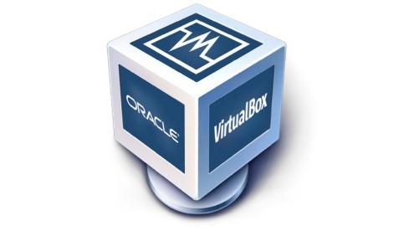


Kubernetes Environment Overview-eNSP
AR1
①
③
capture
②
AR3
VirtualBox
capture
AR2

Slide 14
Kubernetes Environment Overview-eNSP Demo
BGP RR
VTEP
VxLAN Tunnel
VxLAN Tunnel
BGP EVPN
BGP EVPN
BGP EVPN
VTEP
VxLAN Tunnel
VTEP
VxLAN Tunnel
VxLAN Tunnel
BGP EVPN Peer
VTEP

Slide 15
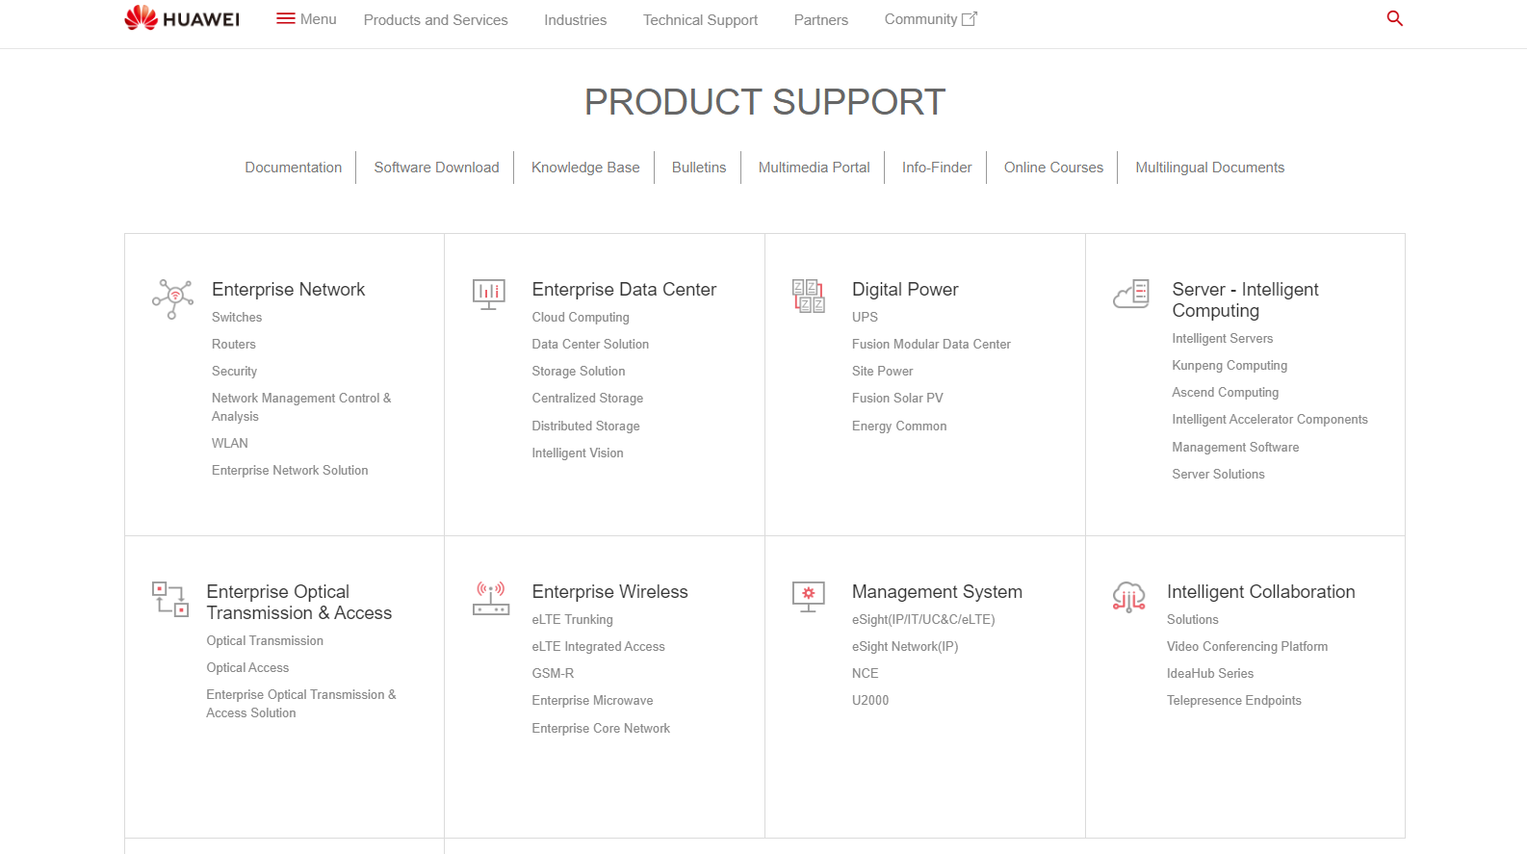
Kubernetes Environment Overview-Docs Reference
https://support.huawei.com/enterprise/en/index.html

Slide 17
Copyright And Confidentiality
All content of this material, including text, images, audio, video,software,programs,tools etc., are collected online.
Visitors may use the content or services provided in this material for personal study, research or appreciation, as well as other non-commercial or non-profit uses, but at the same time comply with the provisions of the Copyright Law and other relevant laws, and may not infringe this information and related the legal rights of the right holder. In addition, any use of any content or service of this material for other purposes requires the written permission of the person and payment.
牧云/罗伟
Network | IaaS | PaaS | ServiceMesh
交流 学习 沉淀 成长 分享
olaf.luo@foxmail.com
https://www.yuque.com/wei.luo
https://youdianzhishi.com
All Rights Reserved.

Slide 18


